Slide 1
Lead Scoring Case Study using logistic regression model
Submitted by :
Vinod Yadav
Vignesh Kumar
Ujjwal Verma

Slide 2
Outline
Executive Summary
Introduction
Methodology
Results
Conclusion

Slide 3
Executive Summary
Summary of methodologies
Data Collection
Exploratory Data Analysis
Identifying Categorical Variables and Creating Dummy Variables
Model Building Using Logistic Regression
Prediction on Test Dataset
Conclusion
Summary of results
Data Analysis along with Interactive Visualizations
Conclusion and recommendations

Slide 4
introduction
Problem Statemen
An education company named X Education sells online courses to industry professionals. On any given day, many professionals who are interested in the courses land on their website and browse for courses.
Company markets its courses on several websites and search engines like Google. Once these people land on the website, they might browse the courses or fill up a form for the course or watch some videos. When these people fill up a form providing their email address or phone number, they are classified to be a lead. Moreover, the company also gets leads through past referrals. Once these leads are acquired, employees from the sales team start making calls, writing emails, etc. Through this process, some of the leads get converted while most do not. The typical lead conversion rate at X education is around 30%.
Although X Education gets a lot of leads, its lead conversion rate is very poor. For example, if, say, they acquire 100 leads in a day, only about 30 of them are converted. To make this process more efficient, the company wishes to identify the most potential leads, also known as ‘Hot Leads’. If they successfully identify this set of leads, the lead conversion rate should go up as the sales team will now be focusing more on communicating with the potential leads rather than making calls to everyone.

Slide 5
introduction
Goals of the Case Study:
To build a logistic regression model to assign a lead score between 0 and 100 to each of the leads which can be used by the company to target potential leads.
To adjust to if the company's requirement changes in the future so you will need to handle these as well.

Slide 6
Methodology
Goals of the Case Study:
Data Preprocessing
Data Visualization
Model Training
Model Testings
Metrics Comparison
Conclusion

Slide 7
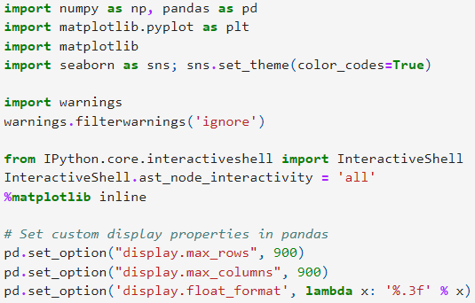
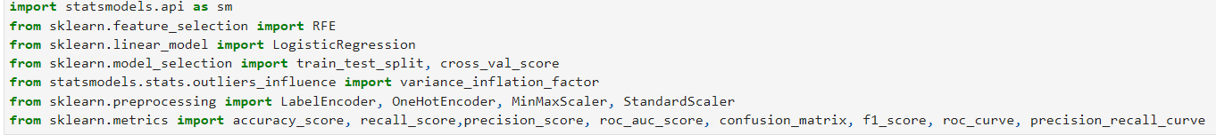
Data Preprocessing
1. Package Imports and Data Initialization
With this code We have imported all libraries numpy, pandas, matplotlib, seaborn.
With below mentioned code We have imported necessary machine learning packages (sklearn, statsmodel) for performing logistic regression

Slide 8
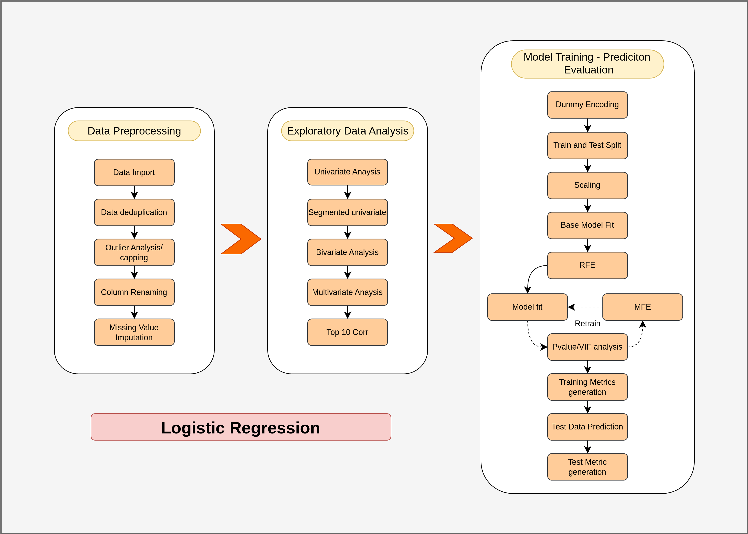
Data Preprocessing - Part 1
Steps in logistic regression model

Slide 9

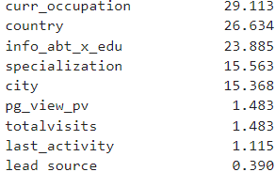
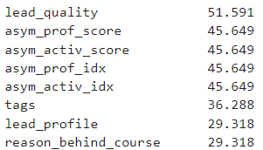
Data Preprocessing
#We have created Custom Functions for Preprocessing and EDA
def classify_feature_dtype(df, cols):
def show_stats(df, cols):
def check_cols_null_pct(df):
def univariate_plots(df, cols, target=None, ftype=None, l_dict = None):
def get_extremeval_threshld(df, find_outlier=False)
# With the below mentioned code we have drop unnecessary columns
#below mentioned code will give us the shape and size of the data frame
# With the below mentioned code we have# checked null val percentage
# After checking the null value percentage for all the features
# We could see that there are many features that have more than 45% of non values

Slide 10
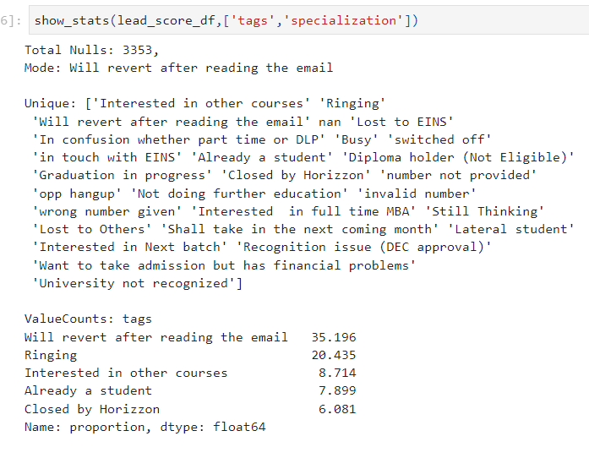
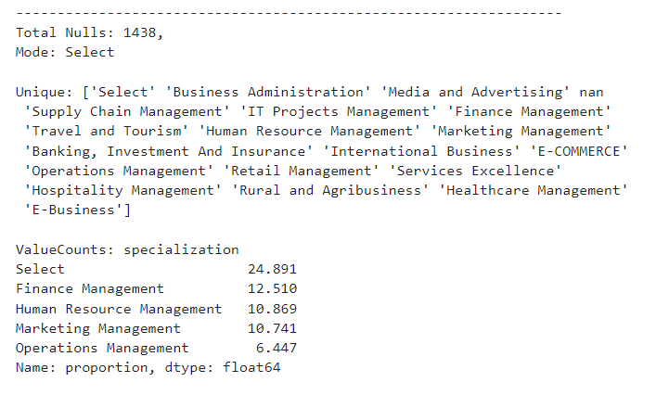
Data Preprocessing
In Tags and and specialization we have replaced select and nan values with unknown, and remove the unknown values after doing dummification

Slide 11
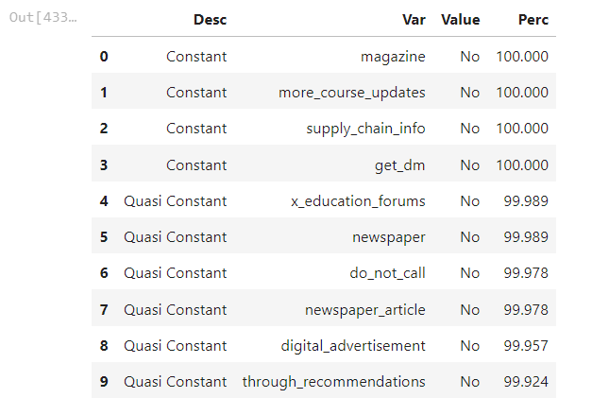
Data Preprocessing
Below mentioned code has replace select string with nan
We have checked constant features that has only one values
In the given data set there are a lot of features that have only single value as a category
These are called as constant features and these features are of little relevance for the machine learning model hence we dropped those features
have Constant Feature Identification

Slide 12
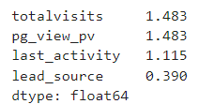
Data Preprocessing
# impute missing categorical values using mode, if a particular value in that column has higher frequency say > 50%
# Now there are only two columns that have more than 36 off missing values tags and specialization

Slide 13
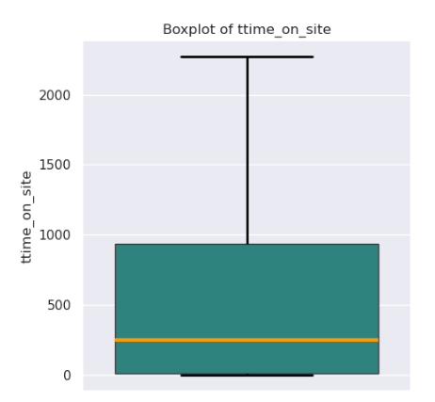
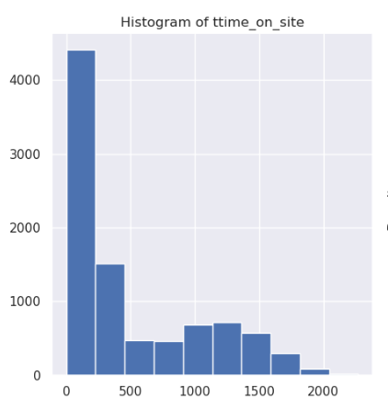
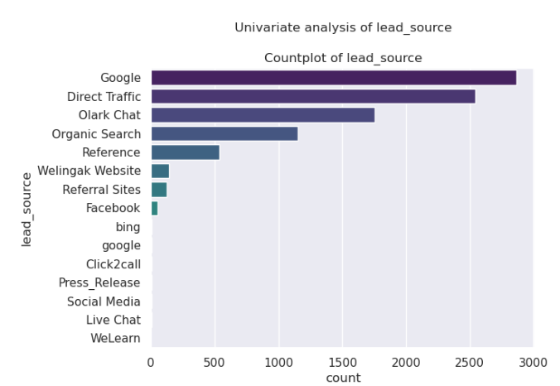
Data Visualization
univariate plots

Slide 14
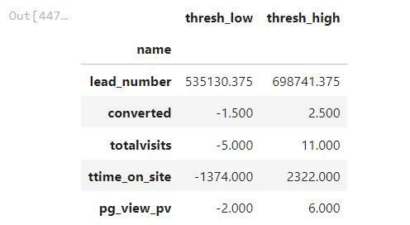
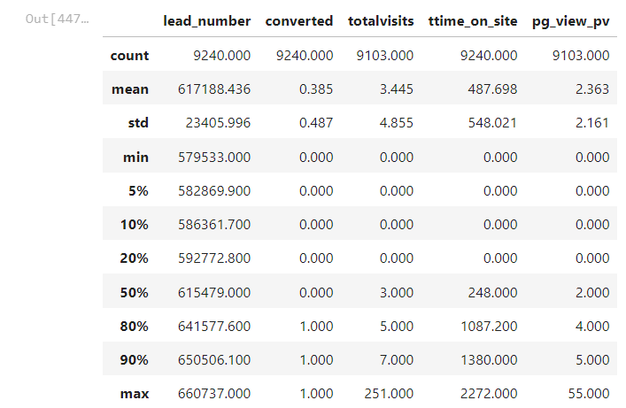
Data preprocessing part 2
Outlier Analysis and Capping

Slide 15
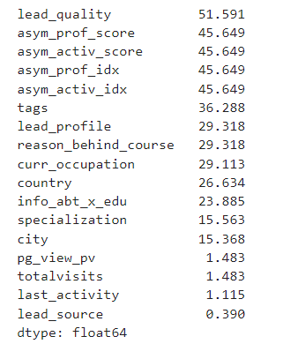
Data preprocessing part 2
there are few null values in their total visits and page view pub features therefore we replace with the mean of that particular column
#WE checked OUR null val percentage
#After checking the null value percentage for all
the features
#We could see that there are many features that have more than 45% of non values significantly reduced
Data Imbalance & Conversion Ratio
# From the target variable we have found out the imbalance ratios around 62 therefore we decide not to rebalance

Slide 16
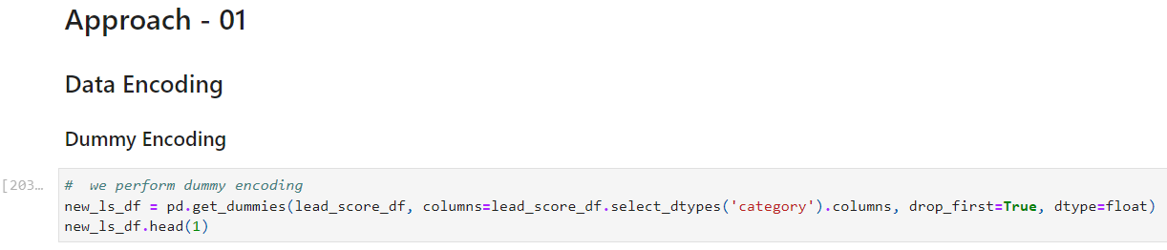

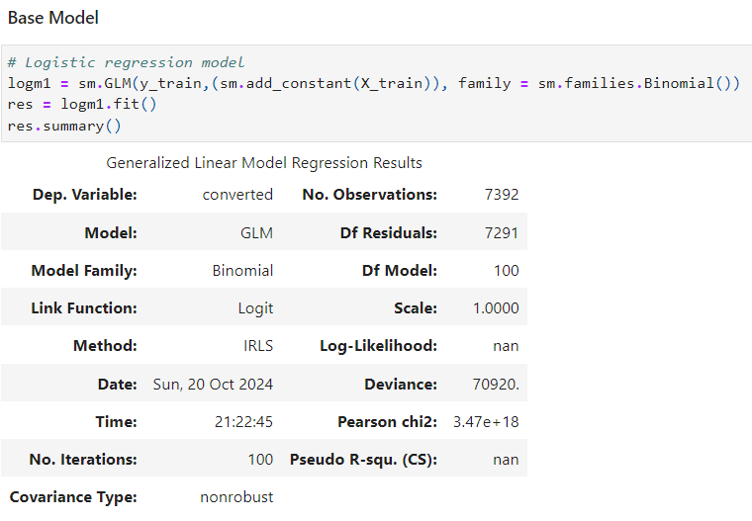
Data preprocessing part 2
we have performed dummy encoding
we have used custom functions for model training
Output
# Logistic regression model

Slide 17
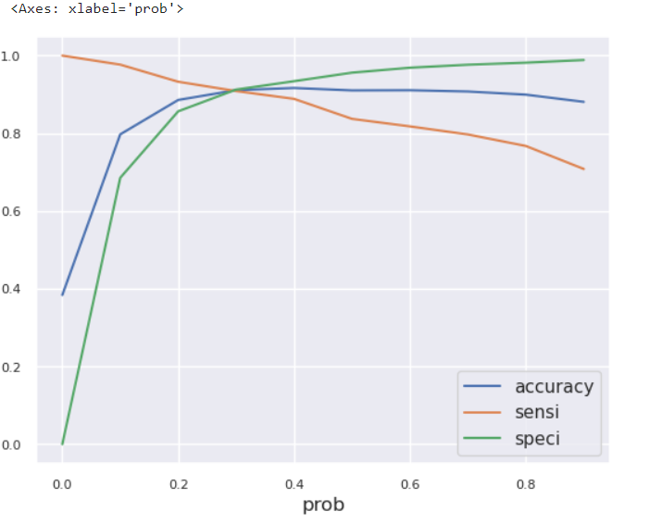
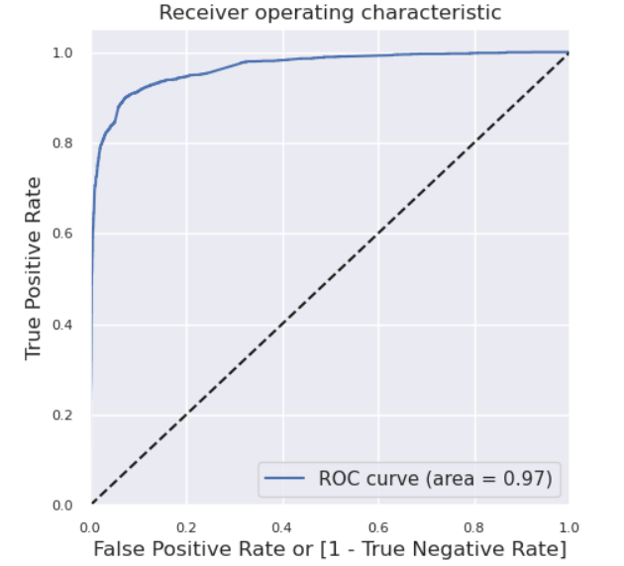
Data preprocessing part 2
We have plotted accuracy sensitivity and specificity for various probabilities.
ROC Curve and Precision - Recall Curve

Slide 18
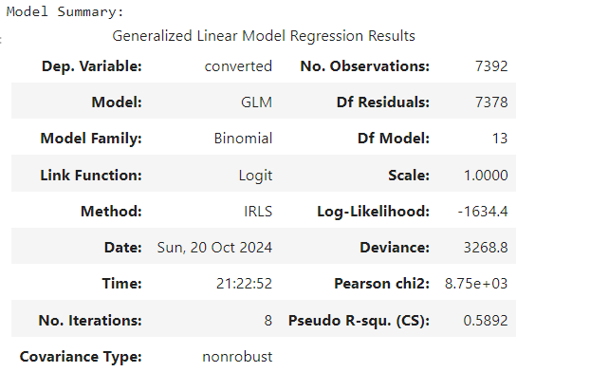
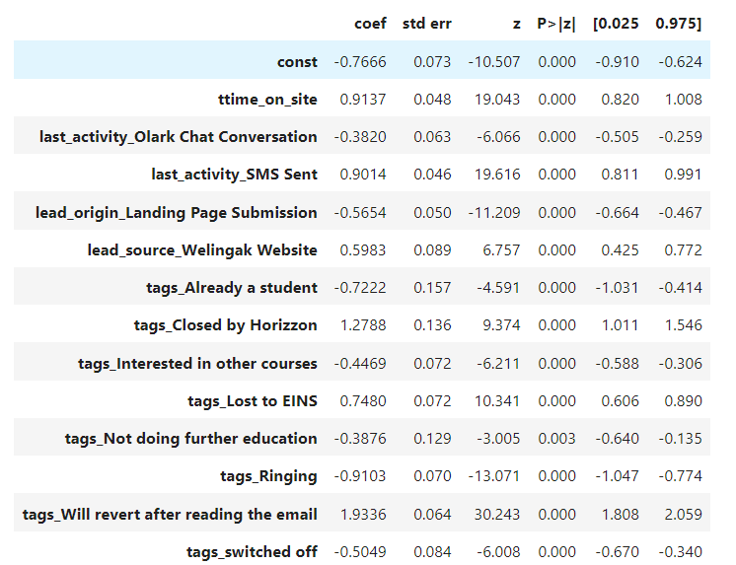
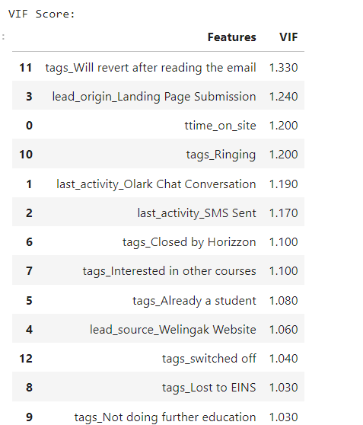
Data preprocessing part 2
Model Validation on Test Data

Slide 19
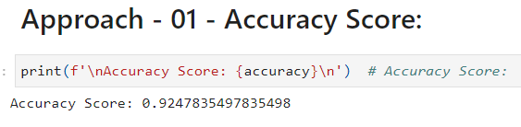
Data preprocessing part 2
Accuracy score for the Model is 92 %

Slide 20
THANK YOU
Mirjam Nilsson​
mirjam@greatsiteaddress.com
www.greatsiteaddress.com

